Slide 1
Welcome to
3D Design at
Cirencester College

Slide 2
What projects can I do?
Architecture
Landscape Design
Sculpture
Product Design
Furniture
Lighting
Interior Design
Transport Design
Jewellery and Costume
Design for Game, Film and Stage

Slide 3
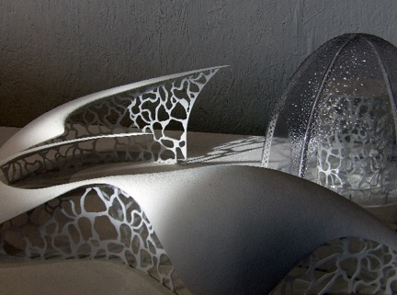
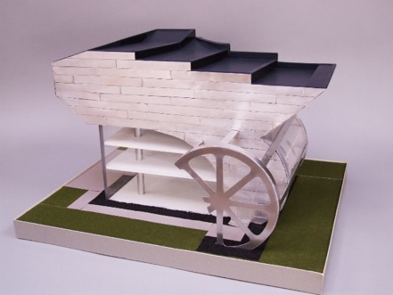
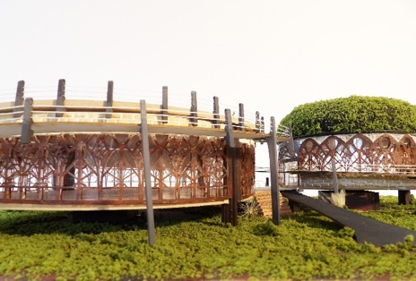
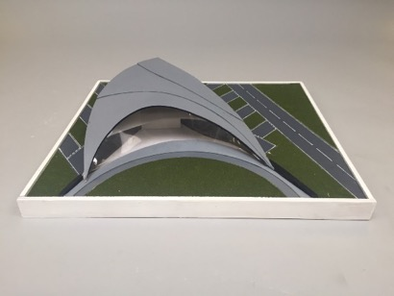
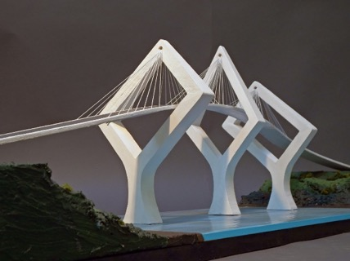
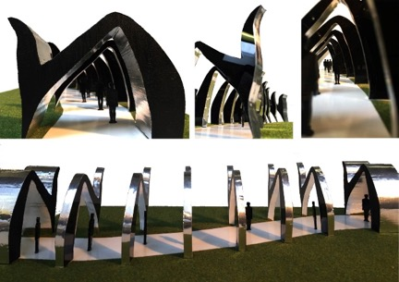
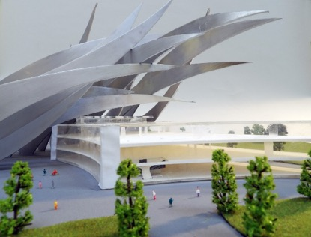
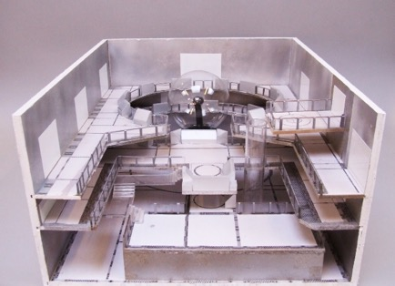
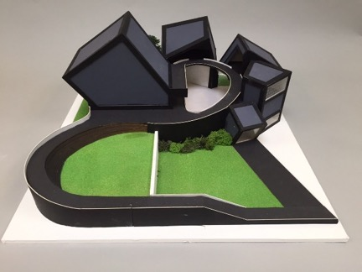
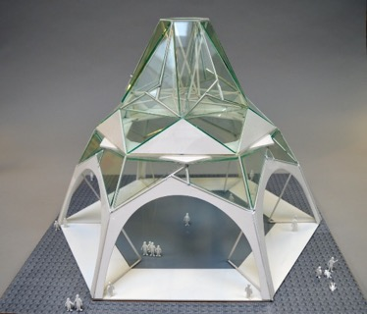
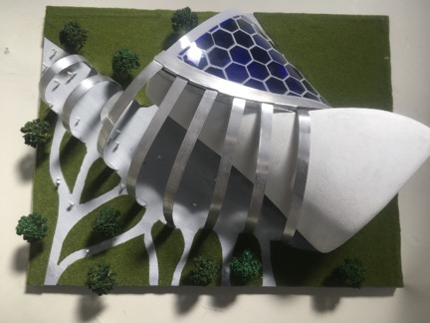
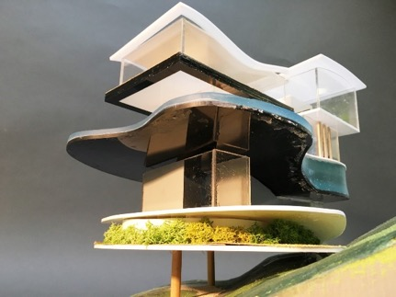
Architecture & Landscape Design

Slide 4
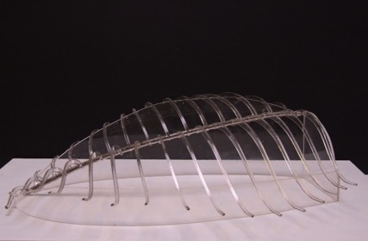
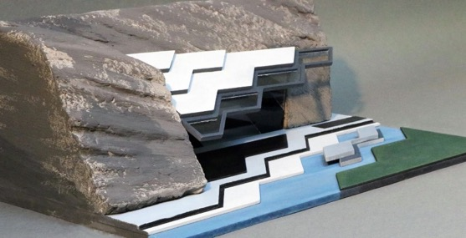
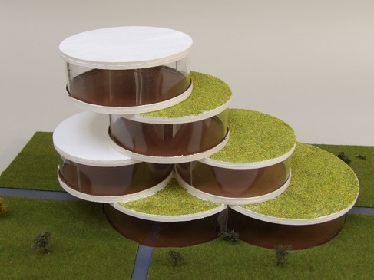
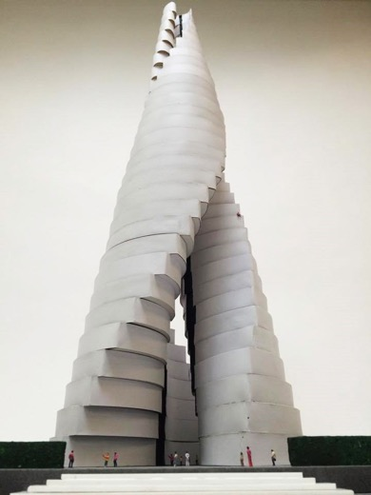
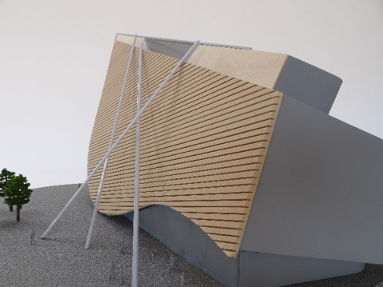
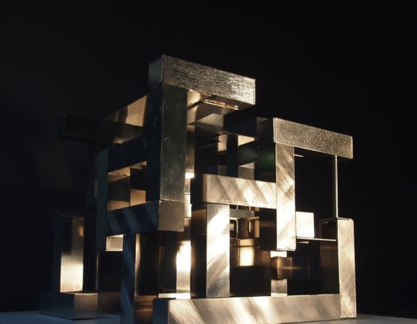
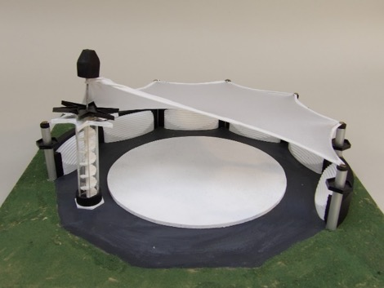
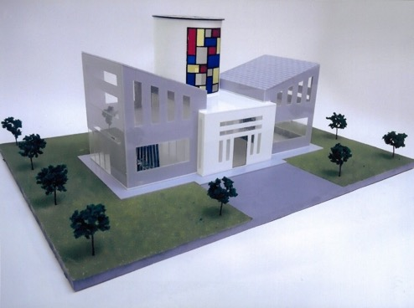
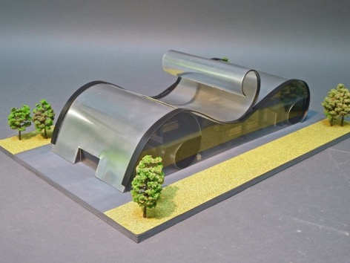
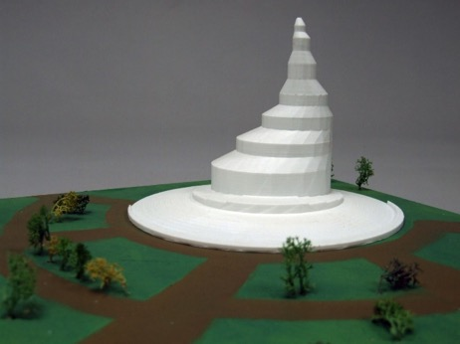
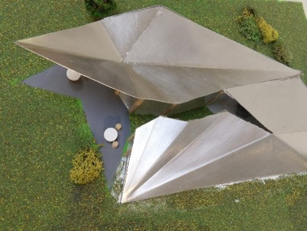
Architecture &
Landscape Design

Slide 5
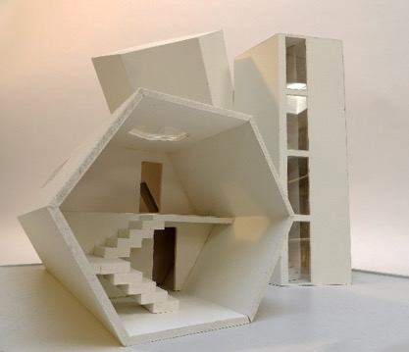
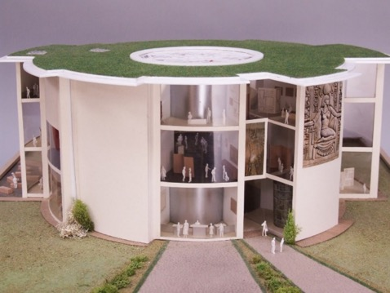
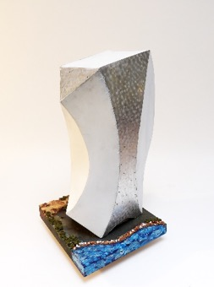
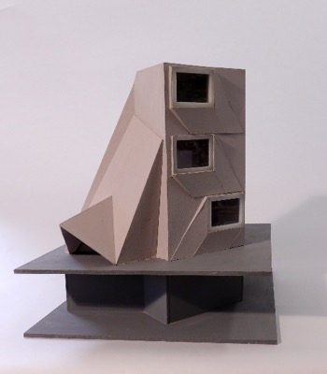
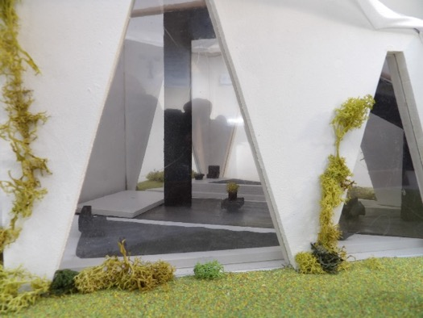
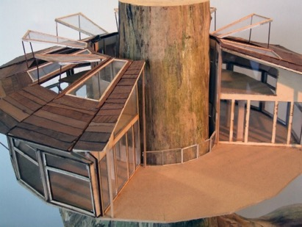
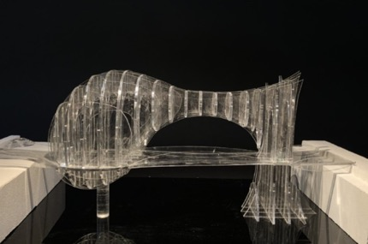
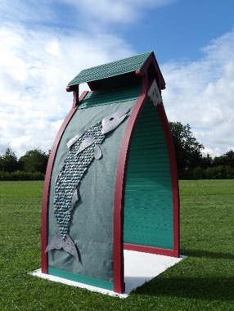
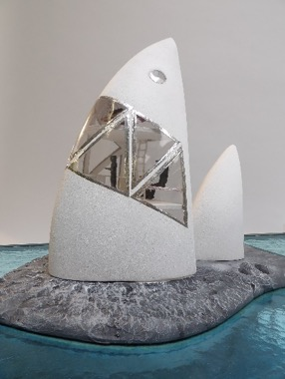
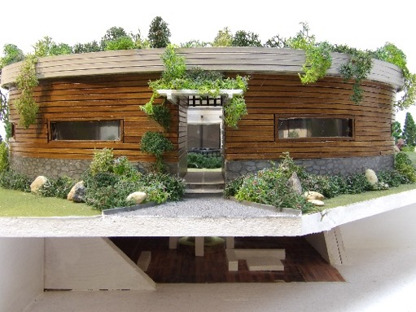
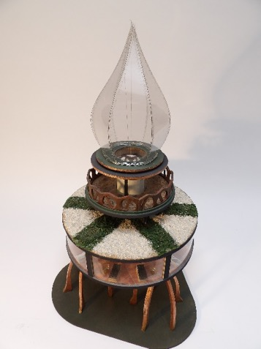
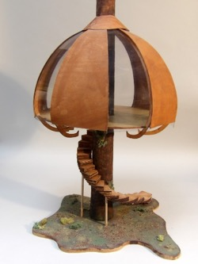
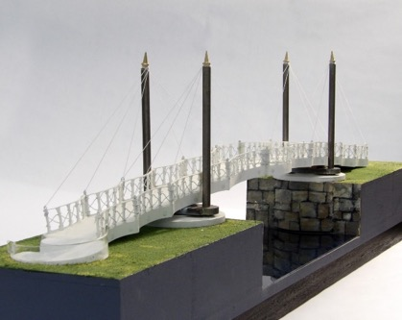
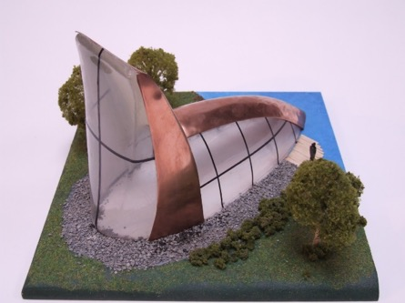
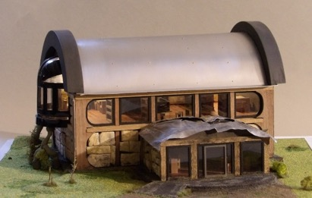
Architecture &
Landscape Design

Slide 6
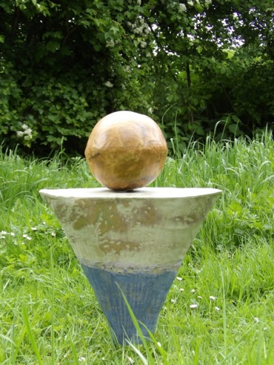
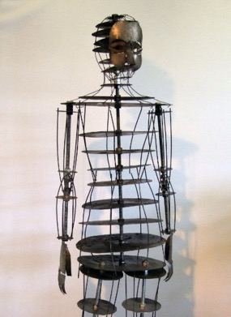
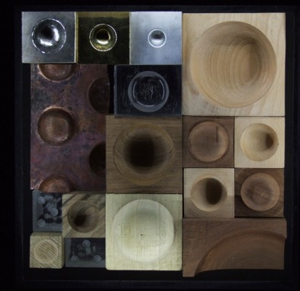
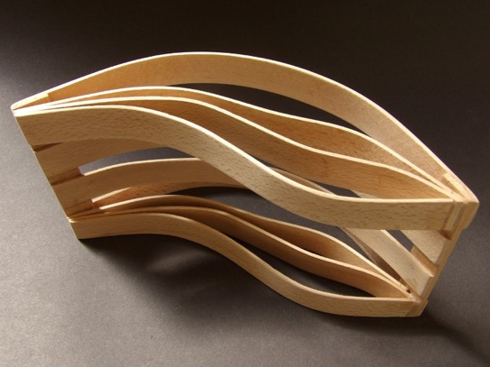
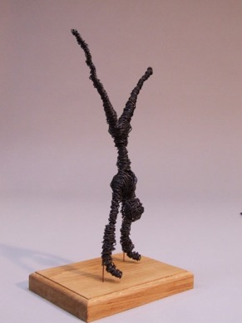
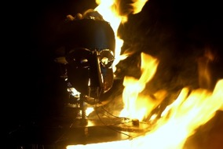

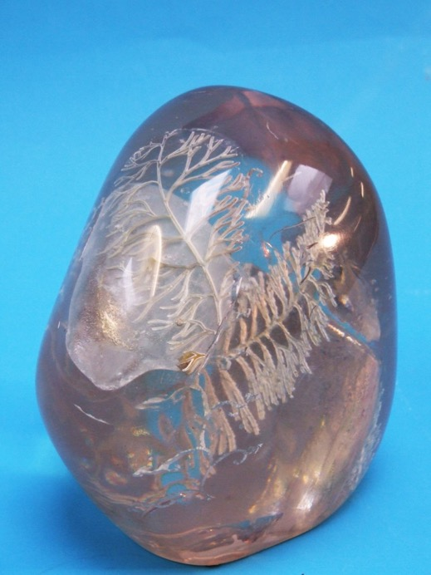
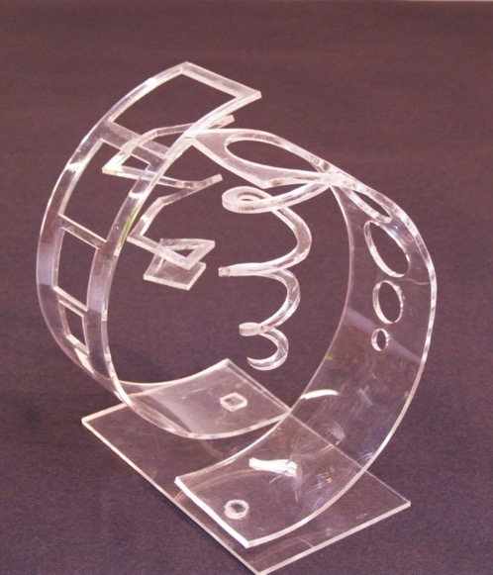
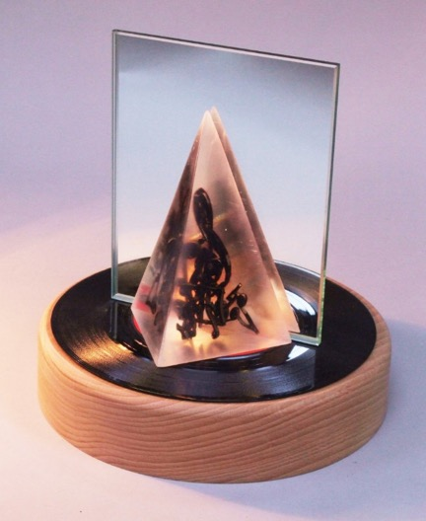
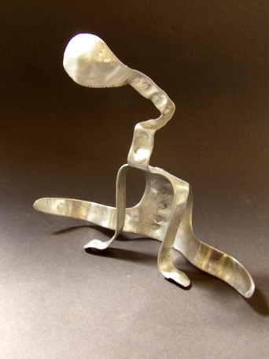
Sculpture

Slide 7
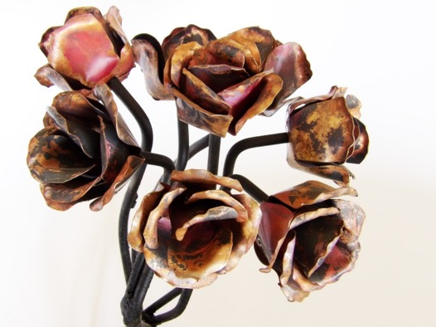
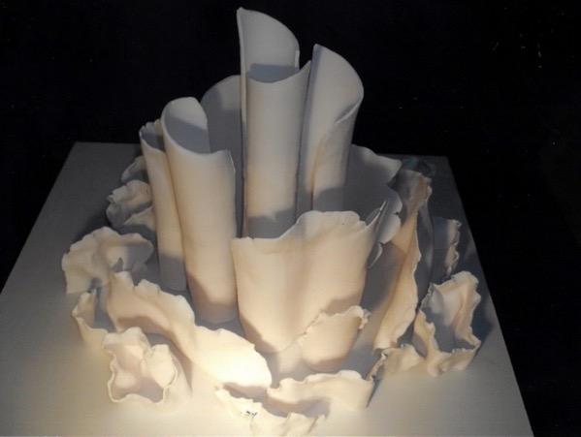










Sculpture

Slide 8












Product Design

Slide 9











Product Design

Slide 10















Furniture

Slide 11
















Furniture

Slide 12















Lighting

Slide 13



















Lighting

Slide 14











Lighting

Slide 15







Transport Design

Slide 16















Jewellery and Costume

Slide 17






Jewellery and Costume

Slide 18
You will thrive on this course if you enjoy:
Researching the work of other artists and designers
Finding sources of visual inspiration and using them to create new ideas.
Drawing from observation
Sketching ideas
Developing proposals
Presenting concepts
Using technology as part of the creative process (CAD/CAM)
Working with materials to create new designs and solutions.

Slide 19
Course structure
Term 1 Introductory Mini Projects
Term 2: Self selected Mini project
Start Personal Investigation,(60%) Research and exploration
Term 3 Personal Investigation : Developing a proposal and the Extended Written Element.
Term 4 Personal Investigation: Further development and creation of the final piece.
Term 5 Personal Investigation: Conclusion, presentation and evaluation.
Externally Set Assignment (40%) Responding to one of 12 given themes.
Term 6 Externally Set Assignment , final preparations and the 15 hours (5 hours, 3 days) of controlled time.

Slide 20
What subjects go with 3D Design?
3D can be put with almost any combination of other subjects.
You can do one other creative A level subject with 3D Design but you can’t do three A levels that are all creative (Fine Art, Textiles Graphic Communication, Photography,)
You can do the CTEC Art and Design plus 3D Design.
Choose other subjects that you will enjoy.

Slide 21
2020 Progression
Student | Course/Career | Where? |  | Student | Course/Career | Where?
Ben Waldron | Architecture | Bath University |  | Samantha Fealty | Art Foundation | Stroud
Charlotte Evers | Self employed Artist/designer | Swindon and Devon |  | Peter Vater | Employment/apprenticeship
Josh Venn | Product and furniture Design | University of Arts London |  | Caiden Williams | Architecture | Reading University
Cerys O’Brien | Architecture | Plymouth University |  | Ben Pearce | Employment/apprenticeship
Charlotte Parsons | Geography | Bristol |  | Devon Winch | Architecture | Reading University
Elizabeth Sellwood | Engineering | Cardiff University |  | Angelica Oliviera | Graphic Communication | University of Wales
Anton Maczulski | Civil Engineering | Cardiff University |  | Alfie Alcock | Employment/apprenticeship
Ellie Heath | Interior architecture and Design | UCA Farnham |  | Jack Bailey | Employment/apprenticeship
Ben Latham | Outdoor adventure and education | Plymouth University |  | Pavel | Employment/apprenticeship
Sam Newman | Commercial Music | Bath Spa |  | Sam Morgan | Self-employed On-line vintage clothing retail
Ollie Goodenough | Sports/Motor racing industry.

Slide 22
2021 Progression
Student | Course/Career | Where? |  | Student | Course/Career | Where?
Tom Burge | Apprenticeship at Corin Medical/B. eng in Biomedical Engineering. |  |  | Sam Wright | Business management | UWE.
Antonio Causer | Product and Furniture Design BA | Plymouth |  | Sophie Day | Gap year/seeking apprenticeship.
Reuben Dodd | Boat building apprenticeship | Neilson. Gloucester docks. |  | Josh Francis | Seeking Design/Photography apprenticeship.
Cam Edwards | Mechanical engineering (M.eng) | Plymouth |  | Fred Hall | Product Design BA | Coventry
Amina Elgharbawy. | Art foundation | Stroud. |  | Ryan Ng | Game Design
Dylan Higginson. | Gap year/seeking apprenticeship. |  |  | Elliot Starsmeare Ferris | Gap Year
Callum Radford |  |  |  | Jim Pillow | Product Design BA | Coventry
Elijah Ready | Gap year/seeking Design apprenticeship. |  |  | Sophia Wathen | Art foundation | Stroud
Harrison Steer | Gap year/seeking Engineering apprenticeship. |  |  | Joe Wiles | Architecture BA
 |  |  |  | Harry Woolls | Employment TBC
Pete Tipping | Physical Geography |  |  | Pep Boixader | Quantity Surveying
Ted Williams | Furniture Design and Make | Oxford Brookes |  | Fin Cummins | Art foundation | Falmouth

Slide 23
Past Students
Rob Skarda
Zoe Rae
Tom Postlethwaite
Sam Glover
Alyssia Booth
Joel Carr
Megan Thacker-Brooks

Slide 24


Tom Postlethwaite
Tom exhibited at “Young designers” (2018) where this design called “Plank” was selected for their “top picks”
Tom is currently an industrial Designer at Notpla

Slide 25


Megan Thacker-Brooks
Megan Studied architecture at Cardiff University and is currently at Ollier Smurthwaite Architects as an Architectural assistant

Slide 26


Joel Carr
Joel studied Design at Nottingham Trent University where he developed this product.

Slide 27

Sam Glover
“I’ve just left Practical Classics magazine after a decade as Technical Editor. While I figure out what to do next, I might as well kill time doing what I most enjoy and what I’m best at: working on classic cars. I have a luxurious workshop near Cirencester, Gloucestershire. If you have a project that would benefit from expert input, do get in touch... I’ll think about it”
(Text taken from Sam’s facebook page)

Slide 28


Zoe Rae
Zoe moved to Oslo after graduating from Brighton. Between walking from Goldsmiths! and joining Brighton in Yr 2 she had 9 months to kill so we set up an internship with a young designer in Oslo. It was a game changer as it offered everything she loves as in craft, culture and wilderness.
Brighton offered a brilliant course in Craft Design. She picked up an Award in yr 2 then 3 more at Graduation. Her ‘ Hunter Gatherer in the Anthropocene’ project was freighted to Lille this summer as part of the European Design & Culture Festival there. Her work was spotted by one of the worlds foremost Trend Predictors and now featured in a new book on sustainable design trends.
Zoe Jo Rae studied 3D Design & Craft BA(Hons) at Brighton (2017) For her final project, entitled ‘Hunter Gatherer in the Anthropocene’, she created a canoe from milk bottles, as well as trousers made from flour sacks

Slide 29


Alyssia Booth
Alyssia studied Architecture at Bath University and is now a fully qualified architect working for Yiangou Architects here in Cirencester
Below: Images from her degree. Right Professional project completed with the Yiangou practice

Slide 30



Rob Skarda
Founder and Director of Steller systems
“My specialisation is in the concept design, design analysis and integration of warships and submarines. I have designed surface combatants from 500 to 12000 tonnes, naval auxiliaries and tankers from 5000 dwt to 34000 dwt and submarines from 500 tonnes to in excess of 20000 tonnes.”

Slide 31
To succeed on this course you should be:
Motivated
Creative
Imaginative
Inquisitive
Skilful
Analytical
A problem solver
Patient
Thorough
Determined

Slide 32
Minimum entry requirements
Grade 4 or a MERIT or DISTINCTION at BTEC Level 2 in Art or Design subject.
If you have not studied a creative visual course at GCSE entry may also be made via portfolio/interview. You can show us your own work or undertake a set project.
Your portfolio should include drawings, photos, things you have made and any other evidence of creative work.

Slide 33
Follow these links for more information
Watch this course video, essential for all applicants
https://vimeo.com/428012898
Watch this useful video produced by a student that gives a different perspective
https://vimeo.com/429947427
An interview style video with the course leader
https://youtu.be/R6Z5YRG3yCs
Follow this link to the course information
https://www.cirencester.ac.uk/cco/course_view.php?course=1399
Follow 3D Design on Instagram cirencoll3d

